Slide 1
Prevost 2023 … and Beyond

Slide 2
Agenda
Executive Summary
Review of Key Objectives & Critical Success Factors
How did we do?
Organizational Overview
Top Issues Facing Company
Revenue and Profit
Summary
GOALS FOR NEXT PERIOD

Slide 3
Executive Summary
To support the future growth of our business, Volvo Group found ways to more efficiently manage our business as the following demonstrates:
Situation
With a growing world population, ongoing urbanization, and growing e-commerce, demand for transport and infrastructure will continue to increase.
Following the economic rebound after the COVID-19 pandemic, customers have continued to operate with high activity levels.
Complication
Supply of critical components was a limiting factor.
Disruptions, unpredictability and the war in Europe became a tragic reality.
Resolution
Colleagues across the Volvo Group family have taken responsibility, supported each other and worked together with our supply partners and in dialogue with our customers to try to deliver on our promises despite all challenges.
Our organizations, teams and colleagues are empowered, and they have responded by finding new, faster, and more agile ways of working.

Slide 4
Review of Key Objectives & Critical Success Factors
What makes Prevost unique?
Prevost, part of the Volvo Group, has access to the financial strength, product development capabilities, and quality manufacturing technology from one of the world’s largest manufacturers of heavy-duty diesel engines and the world’s second-largest motorcoach and transit bus manufacturing group.
What makes Prevost successful?
Prevost creates value for customers by supporting their profitability.
What is Prevost’s vision?
To be the most desired and successful transport and infrastructure solution provider globally.

Slide 5
How Did We Do?
* More information on the Volvo Group’s segments and how they are reported can be found in Note 6 to the Financial Statements.
See: https://www.volvogroup.com/content/dam/volvo-group/markets/master/news/2023/feb/4478811-ab-volvo-annual-report-2022.pdf

Slide 6
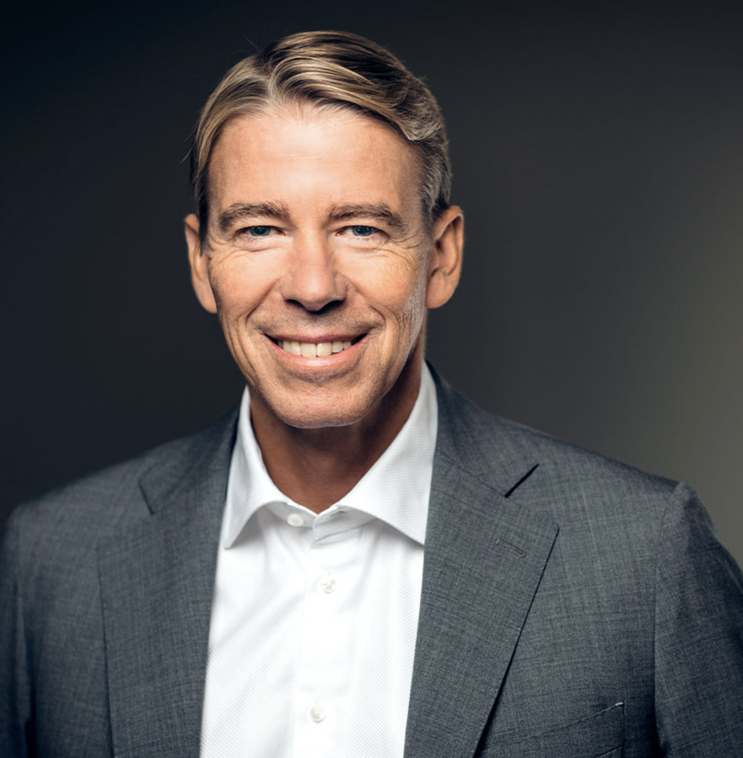
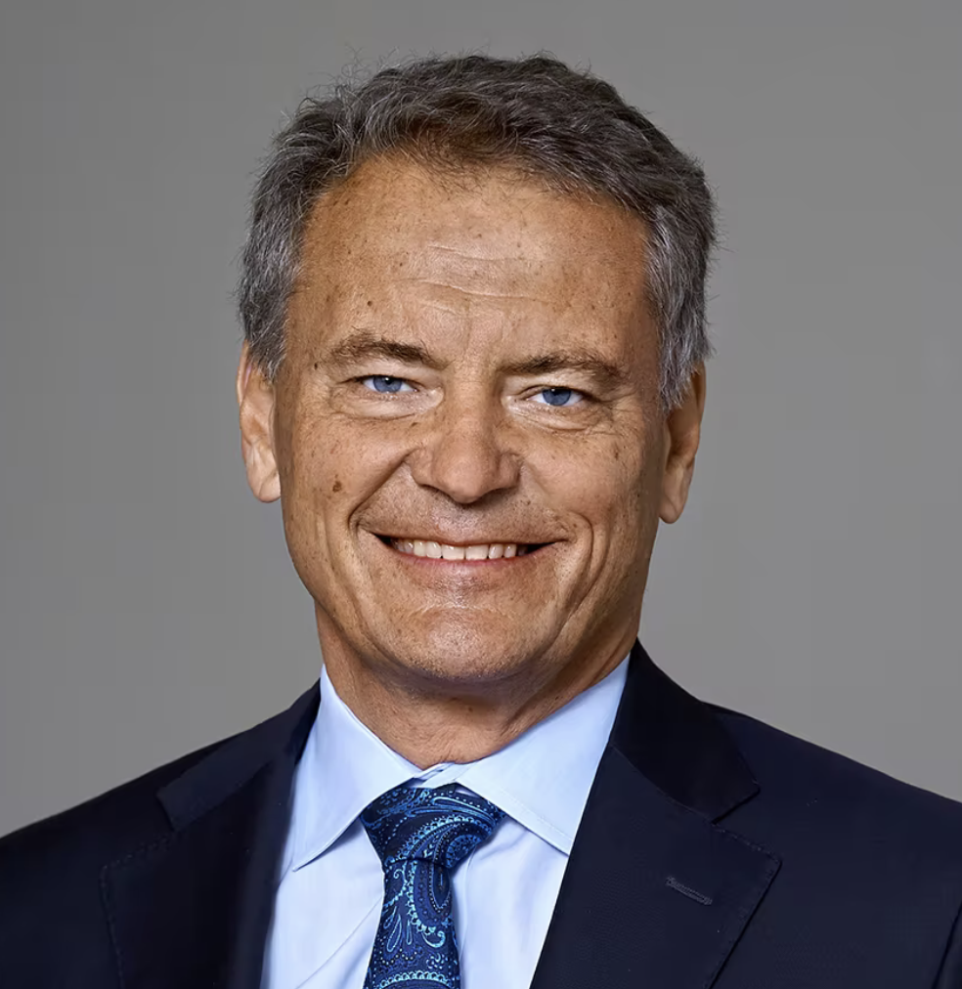
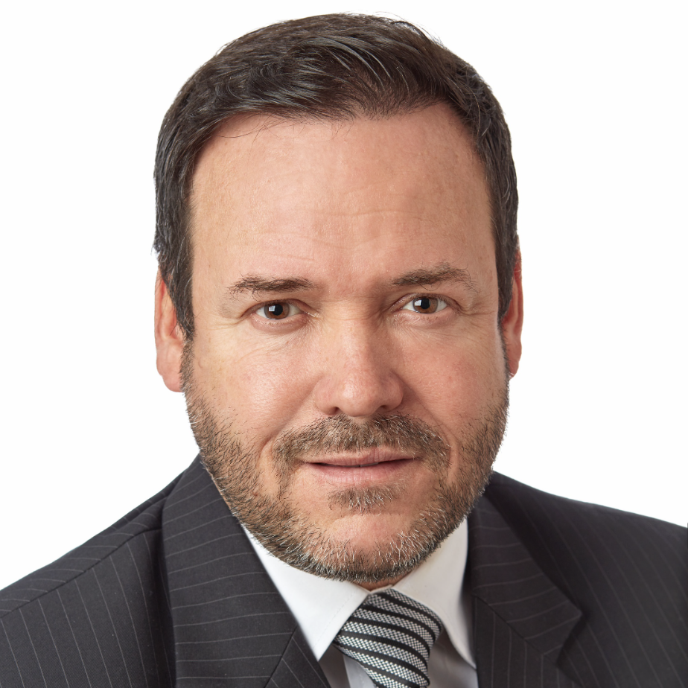
Organizational Overview
Bo Annvik elected
as a new member
of the Board
Carl-Henric Svanberg
re-elected as
Chairman of the Board
François Tremblay appointed President of Volvo Group Canada and leader of Canada’s Country Management Team (CMT)

Slide 7
Top Issues Facing Prevost
Lingering chip shortages over the past year have forced a temporary halt in production at some factories … Volvo to the rescue! Note the following excerpt from Bus and Motor Coach News*:
Less impact on private industry
”Prevost, a Québec-based manufacturer of motorcoaches and bus shells for high-end motorhomes, has experienced twice the normal level of back orders for coaches because of shortages of electronics and plastics. But the company has implemented workarounds that allow it to keep its production line going. “It has been a bumpy two years, but we have been successful at managing our back orders,” said Janique Morrisette, Senior Director of Purchasing at Prevost. “And it has started to get more manageable.” One advantage Prevost has is that it is a subsidiary of Volvo, a major truck and bus manufacturer with enough leverage to tap the supply chain for parts. “We are small, so it is a challenge to find parts. Volvo has really helped us in terms of electronics,” Morrisette said.
*June 2022: https://www.busandmotorcoachnews.com/global-shortage-of-microchips-slows-bus-production/

Slide 8
Revenue and Profit
Strong growth in both vehicle and service sales – net sales increased by 29% to SEK 473.5 billion
Continued good profitability despite supply chain challenges – adjusted operating income increased to SEK 50,467 M (41,015)
Reported operating income amounted to SEK 45,712 M (43,074)
Earnings per share of SEK 16.09 (16.12)
Good operating cash flow in the Industrial Operations of SEK 35.3 billion (29.4)
Return on capital employed in the Industrial Operations of 27.4% (25.3)
See: https://www.volvogroup.com/content/dam/volvo-group/markets/master/news/2023/feb/4478811-ab-volvo-annual-report-2022.pdf

Slide 9
Goals for Next Period
Strategic Undertakings for 2023
As part of our focus on electrified vehicles, Prevost launched a development project with the aim of being able to offer customers an electric coach.
Result?
Total order intake for fully electric buses rose by 36% to 304 units (223),
while deliveries increased by 14% to 240 units (211).

Slide 10
Summary
Challenges
geopolitical turmoil
supply chain constraints
high inflationary pressure
Key goals for 2023
We will continue to find ways to reduce climate impact, use the world’s resources more efficiently, and conduct business more responsibly.
We will continue to find solutions that are considerably more sustainable, productive and safer than today.
We appreciate your ongoing support as Prevost continues to expand.

